Slide 1

Advanced Savings / Investor Calculator
Tomas Walters, Luke Hind, Ethan Dreyer, Evagoras Theophanous, Munish Chopra and Mahin Ali

Slide 2
Outline
Introduction
Existing Savings calculators
Our Aims
Financial Tools Available
The Calculator
Conclusion
Summary

Slide 3
Introduction
Why is saving and investing important?
What is the best way to save and invest for you?
How can advanced saving/investment calculators help?
Why and who may use them?

Slide 4
Do you know which type of Savings Account you would pay your savings into?
Like 👍 the question in the chat if you already know which savings account you would invest in.

Slide 5
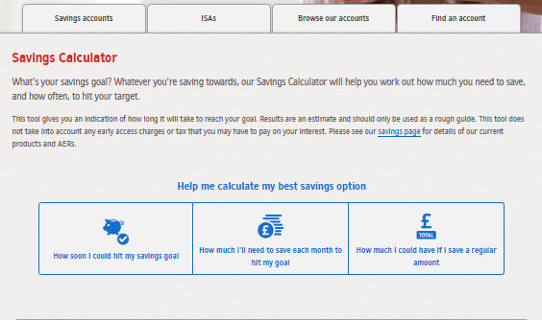
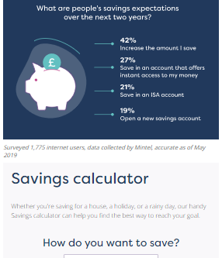
Existing Savings Calculators
Are current market calculators effective for the everyday user?
Often today, many calculators are complicated, offering little to no help confusing potential investors.
In the market, the most effective calculators, have a brief questionnaire to assess and adapt to the needs of the user.
Since investment requirements differ from person to person, this initialization is a necessity for creating something unique, fitting and efficient, all tailored to the user.
Figure 1: Nationwide Savings Calculator, Figure 2: MoneySuperMarket Savings Calculator

Slide 6
Our Aims:
The key to us improving on current calculators was to create key aims to follow as a group when creating our product.
We want our product to be:
Simplistic
Accurate and Trustworthy
Adaptable
Tailored

Slide 7
Financial Tools Available on the Market
What tools are available on today's market?
In the marketplace, products offered contain similar main characteristics; interest on cash with tax applied to this. Each type of account, however, vary in parameters and eligibility, making each of them beneficial over another for a given customers preferences.
Cash ISAs – A type of savings account, which allows customers to earn interest on savings tax-free up to an allowance of £20,000, renewed each tax year.
Fixed Rate ISAs – A Cash ISA, which guarantees the user a specific level of interest for a given period, regardless of market fluctuations. Typically, then longer terms provide higher rates of interest.
Lifetime ISAs – An individual savings account to help 18-39-year olds save for retirement or a new home. The main attraction with this account, is there is a 25% bonus of what you pay in (limitations apply), every tax year, all paid by the government.

Slide 8
Financial Tools Available on the Market
What if an ISA is not what I want, what else is on offer?
Typically, ISAs are one of main savings tools available in today's market. However, luckily there are a wide range of different tools, which may accommodate your needs more sophisticatedly.
Pension Funds – A scheme to provide retirement income. These can be either personal or occupational, which differ in how they are paid. Personal, the employee can solely pay into the account by themselves, whereas occupational pensions require the employer to contribution a minority amount also into an account.
Government Bonds – A government debt-security with a maturity between 10-30 years. Earning interest depending on the type of coupons paid periodically until maturity.
Generally, these saving tools involve little risk, so will be more tailored to the more risk adverse investor (or the general public) in comparison to the likes of trading investment.

Slide 9
Calculator: Assumptions
We used the mean average of the past 10 years (2009 – 2019) of Consumer Price Inflation data in the UK for future inflation rate, which ended up being ~ 2.02%.
For ISA valuation, the deposits are assumed to constant in both the frequency they occur and how much is put in. The market is assumed to be "steady".
For Bond valuation, it is assumed that the user of the product will keep any bond till its maturity date.
The calculator will be used by our target audience, or someone with similar financial investment expenditure.

Slide 10
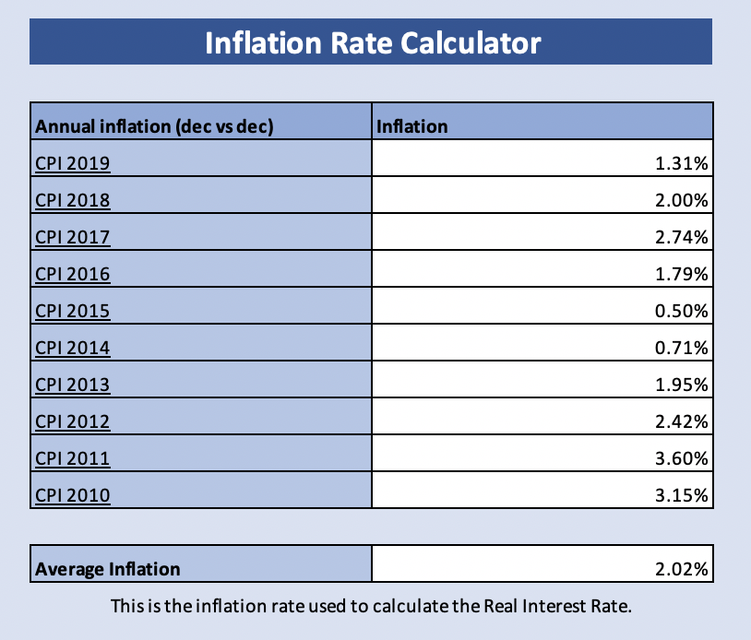

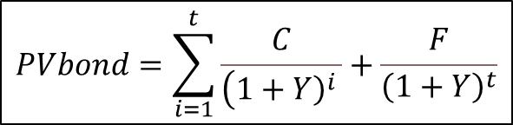
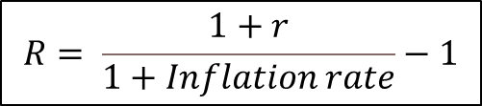
Calculator: Mathematical Models and Formulae
How will our calculator incorporate different financial tools available?
Interest Valuation
Bond Valuation
Formulae:
Variables:
Nominal Interest Rate, r
Real Interest Rate, R
Variables:
Coupon Payments, C
Par Value, P
Interest Rate, r
Yield to Maturity, Y
Time to Maturity, t
Present Value, PV
Face Value, F
$$Y=r+\frac{{\left(P−F\right)}/t}{{\left(P+F\right)}/2}$$
$$PVbond=\sum_{i=1}^{t}{\frac{C}{\left({\left.1+Y\right)}^{i }\right.}+\frac{F}{{\left(1+Y\right)}^{t}}}$$
Inflation.eu. (2020).
$$R= \frac{1+r}{1+Inflation rate}−1$$

Slide 11
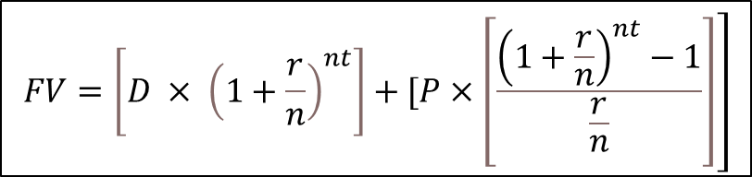
Calculator: Mathematical Models and Formulae
Future Value Annuities
Inputs:
Initial Deposit, D
Value of Each termly payment in, P
Interest Rate, r
The number of times interest compounded per year, n
The Time money is invested for, t
Future Value, FV
Formulae:
$$\left.FV=\left[D × {\left(1+\frac{r}{n}\right)}^{nt}\right]+[P×\left[\frac{{\left(1+\frac{r}{n}\right)}^{nt}−1}{\frac{r}{n}}\right]\right]$$
FV of Deposit
FV of Contribution

Slide 12
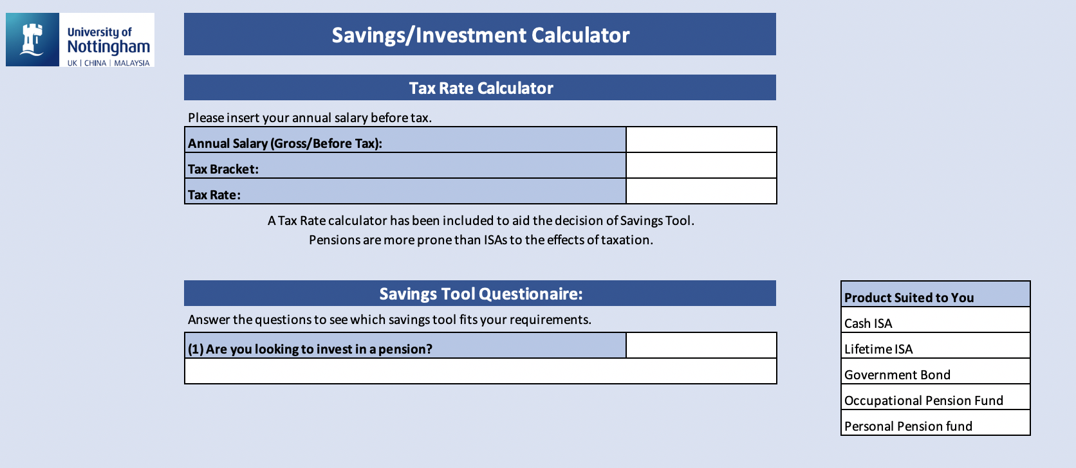
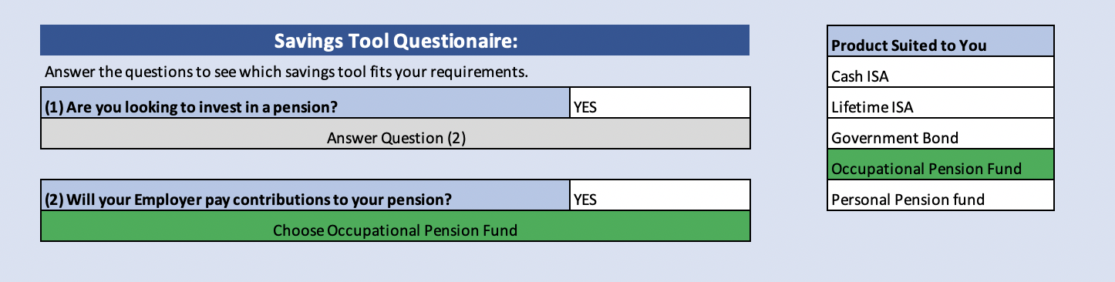
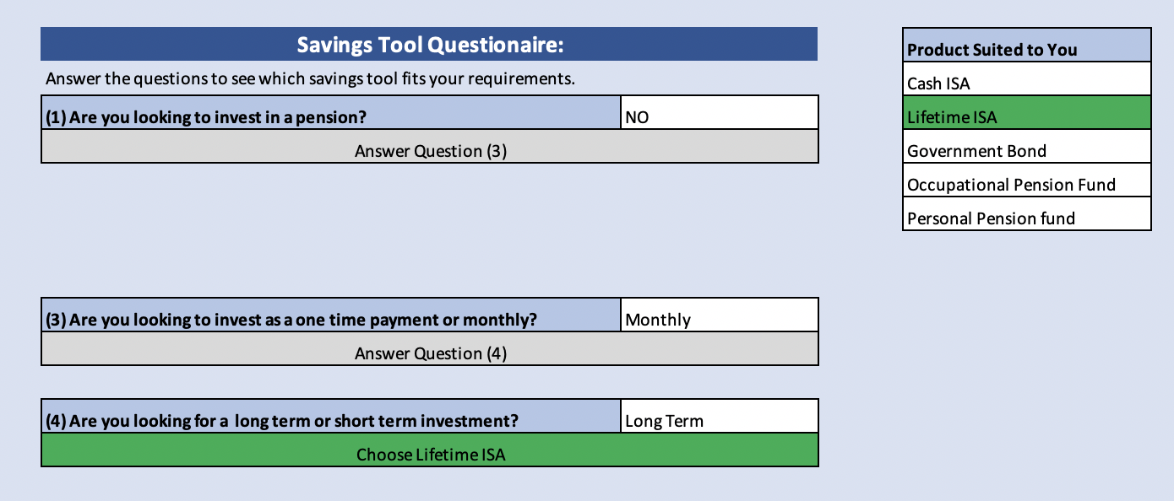
Calculator: Home Page

Slide 13
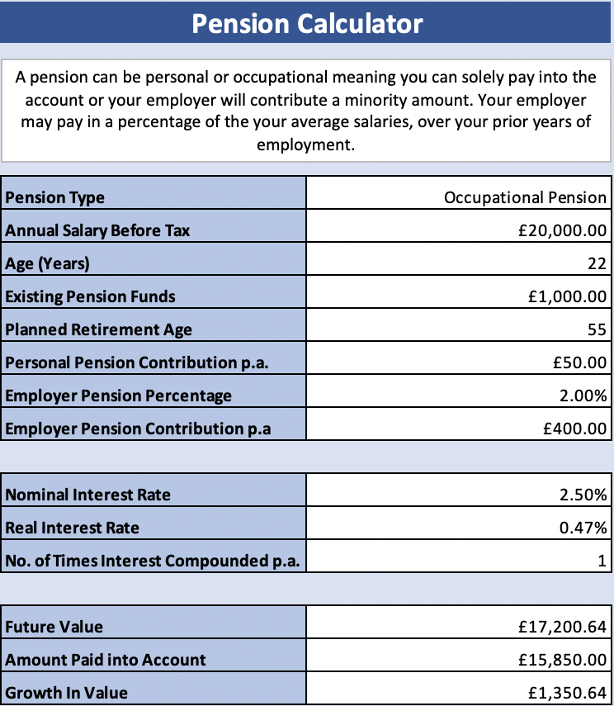
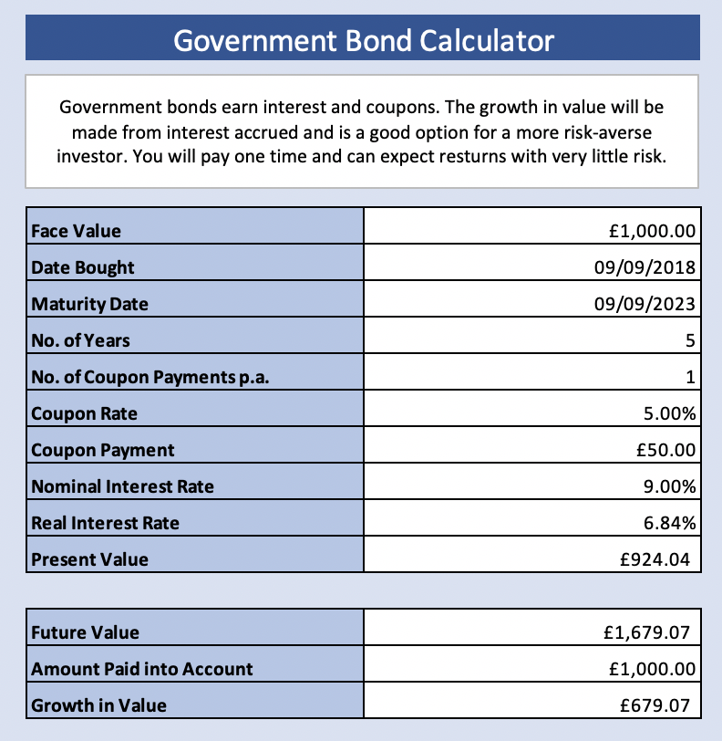
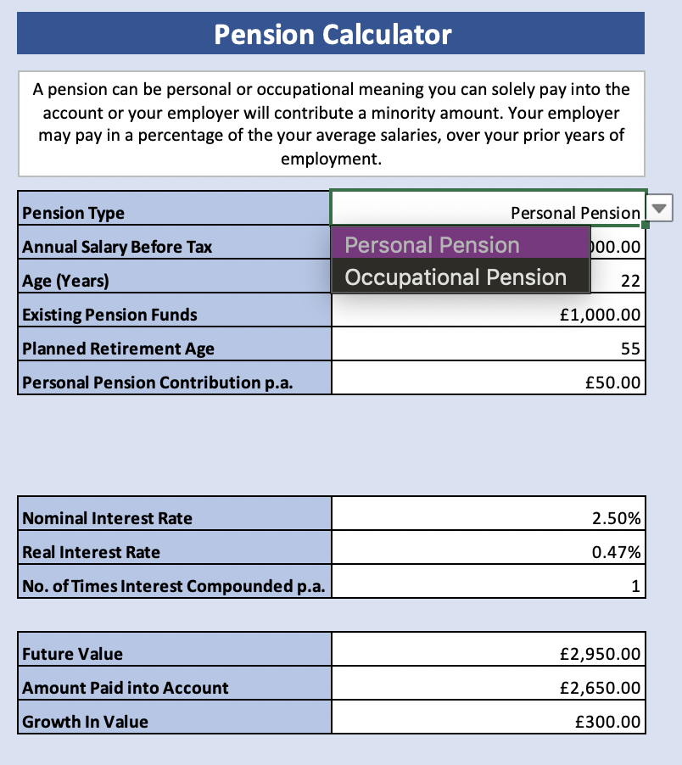
Calculator: Pension Funds and Government Bonds

Slide 14
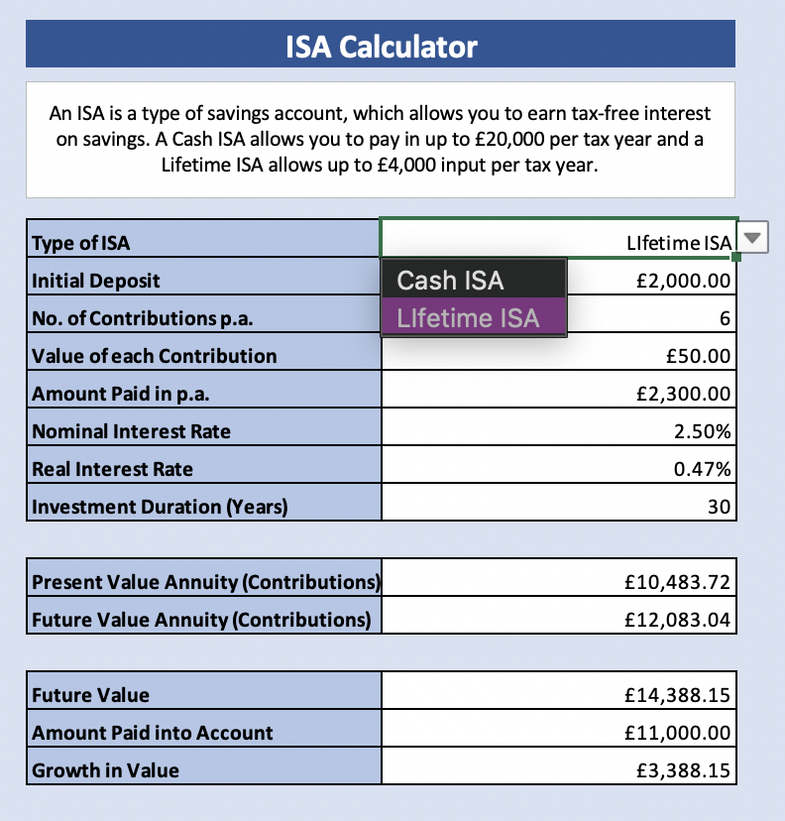
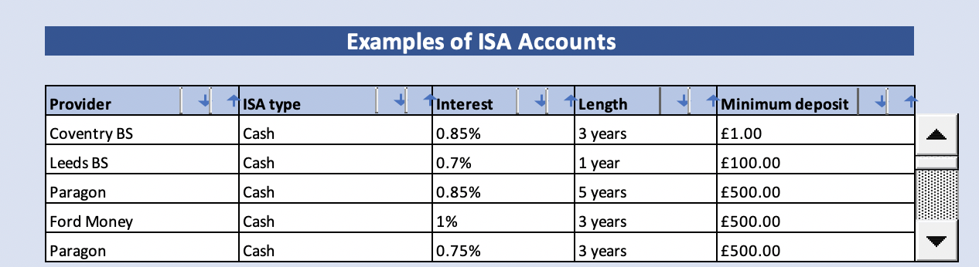
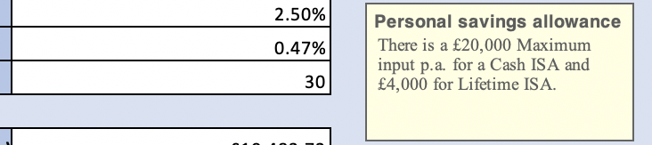
Calculator: ISAs
Sort
Scroll Down

Slide 15
Calculator: Results
Simple confusion free design
Accurate prospects of savings
Easily adaptable for new products
Tailored to the preferences of the user

Slide 16
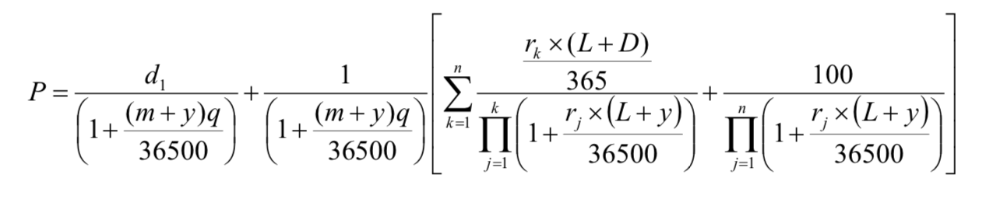
Calculator: Further Model Development
More advanced savings tools (Stocks and Shares ISA)
Include different tiers of ranking for account examples
More risky savings tools (Peer-to-Peer Lending/Corporate Bonds)
More complex valuation formulae, for example…
Debt Management Office. (1998).

Slide 17
Conclusion
A gap in the market has been located
Stable inflation rates offer a favourable opportunity to join the marketplace
The calculator has lots of opportunities for advancement

Slide 18
Summary:
The key to us improving on current calculators was to create key aims to follow as a group when creating our product.
Our product is:
Simple to use and understand
Accurate and trustworthy
Adaptable to modern formulae and accounts
Tailored to the consumers' needs

Slide 19
Now do you know which type of Savings Account you would pay your savings into?
In the chat, like 👍 which Savings Account you would invest in.

Slide 20

References
United Kingdom. Debt Management Office. (1998). Formulae for Calculating Gilt Prices from Yields. Available at: https://www.dmo.gov.uk/media/15011/yldeqns_v1.pdf
Inflation.eu. (2020). Historic inflation GB CPI. Available at: https://www.inflation.eu/en/inflation-rates/great-britain/historic-inflation/cpi-inflation-great-britain.aspx
Thank you for listening
Any Questions?

